Slide 1

June 3, 2021│ Ann Arbor MI
Python for 3D Ultrasound Imaging Using a 2D Scanner
Rick Weitzel
Associate Chief of Staff for Research, VA Ann Arbor Health System
Professor, Medicine, University of Michigan
Ann Arbor, MI
Disclosures: none

Slide 2
Overview: Presentation Outline
Why use a jupyter notebook?
Great work environment for exploring and debugging code blocks
Huge toolset with Python, ipywidgets, and Jupyter notebook
Describe the motivation for the 3D problem
Show Python tools in jupyter notebook (demo)
Images as arrays (discuss, explore and demo)
Adapt these Python tools for imaging (demo)
Conclude with resources and open discussion
2 cardinal rules being broken during this presentation:
Don’t give live coding demos
If you must give a live coding demos have a back up plan

Slide 3
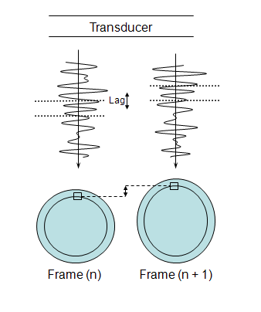
Where did this 3D project come from?
using Python in mechanical imaging
Before
Deformation
Kernel Size
Lag
After
Deformation
Biswas, et al. Sem in Dial 2010

Slide 4
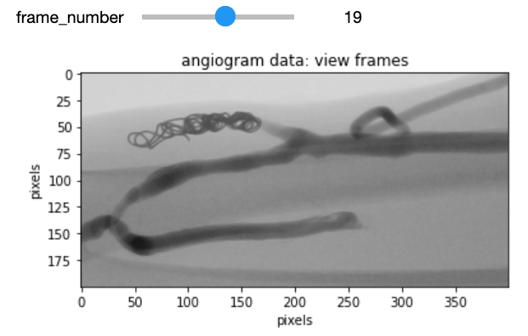
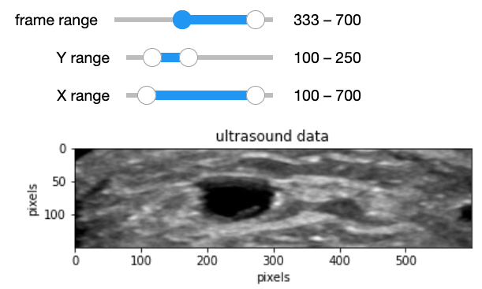
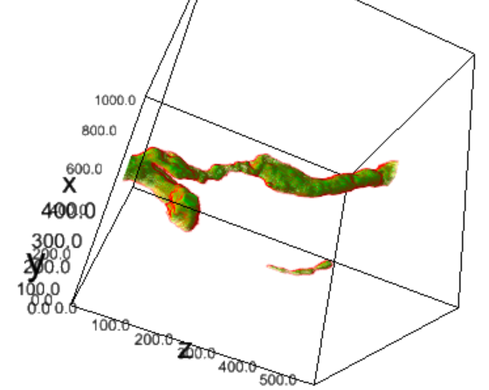
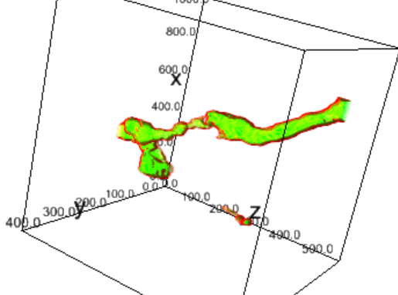
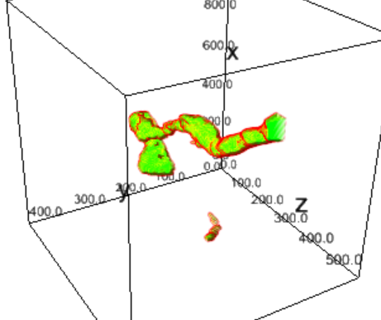
Fun outgrowth: similar tools to
use Python for 3D ultrasound imaging
3D blood vessel data from 2D ultrasound

Slide 5
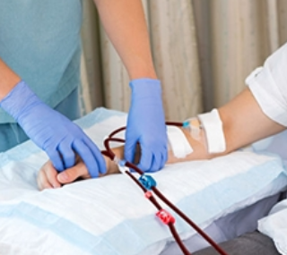
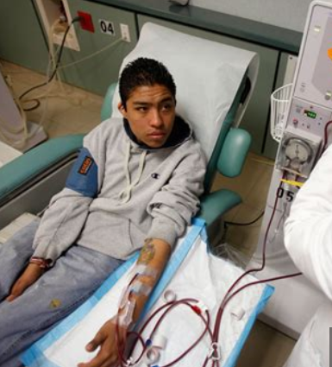
Why image blood vessels?
Many reasons: carotid (neck), legs, dialysis access
Dialysis: enough flow to clean blood in reasonable time
Too much of malfunction from narrowing
Gold standard (angiogram) is invasive
Can we do this non-invasively with ultrasound (very safe)?

Slide 6
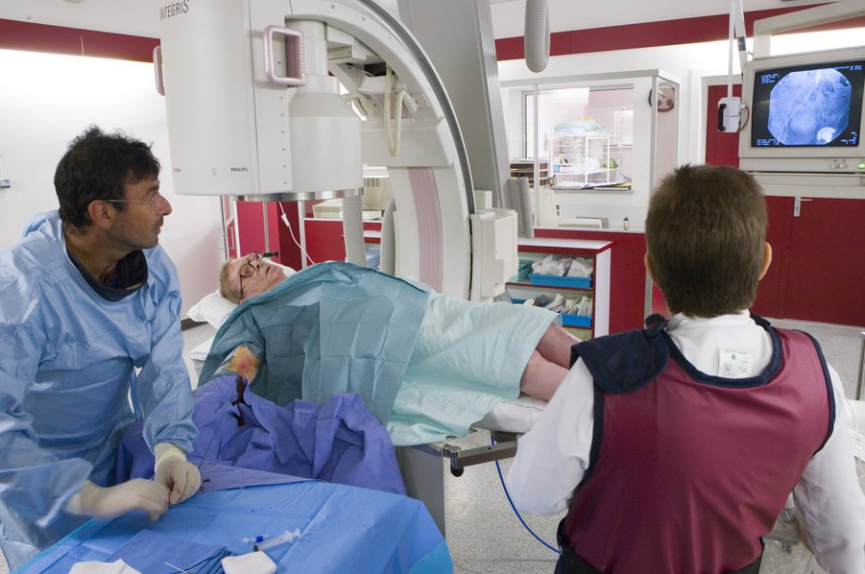
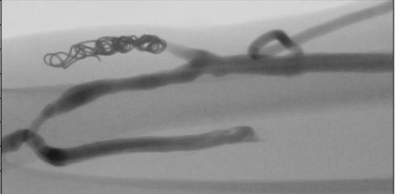
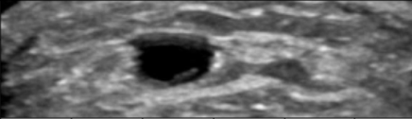
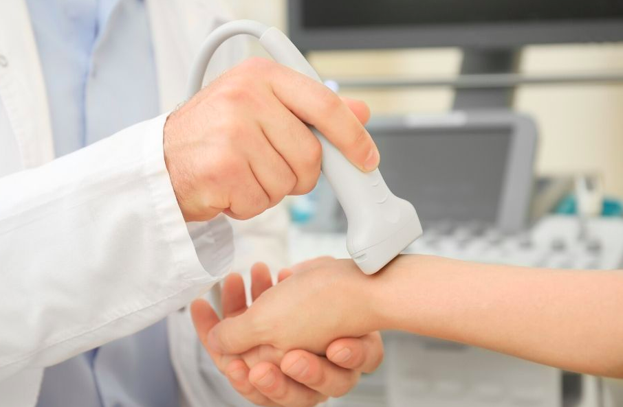
What is an angiogram exam?
What is an ultrasound exam?
What is wrong with
this angiogram picture?
What’s wrong with this ultrasound picture?

Slide 7
Demo
Gold Standard
2D scanner data

Slide 8
Jupyter and ipywidgets
End Goal:
Pull the blood vessel out from rest of ultrasound (image segmentation and segment identification)
View vessel from above: “top down” and other views (array slicing)
Steps: Need tools to interact with the data
Jupyter lab and notebook (to organize and execute code blocks)
Widgets: ”eventful” python objects that use a browser (slider, textbox, etc)

Slide 9
Demo (continued)
Code blocks in jupyter
Use interactivity of widgets to explore the data
Data analysis and visualization

Slide 10
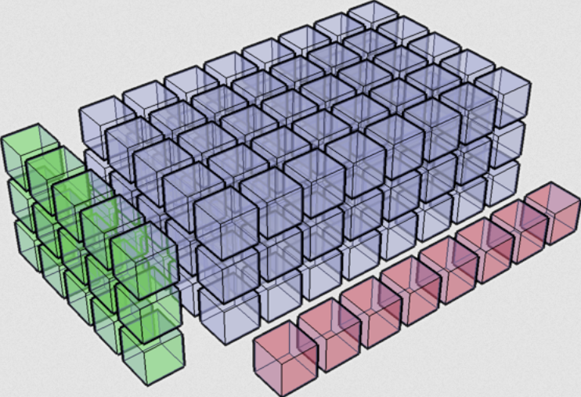
Arrays (as they relate to images)
Array: structure, slicing, data manipulation
(pretend this is a picture)

Slide 11
Demo (continued)
Use widgets to explore the images
Image analysis and visualization

Slide 12
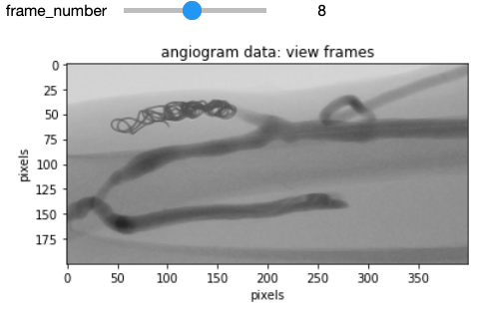
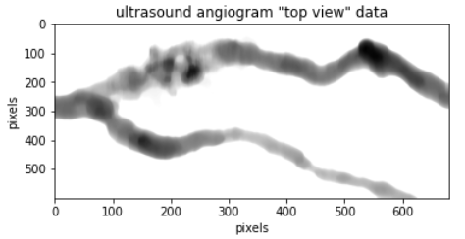
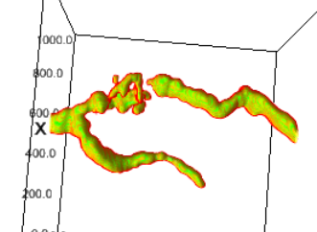
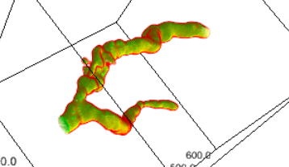
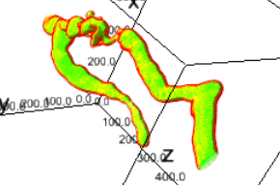
Demo (results)
Original angiogram
“Sono”-angiogram
Additional 3D ultrasound images

Slide 13
Conclusions
Jupyter notebook: using code blocks as tool for developing code for future use
Interactive widgets to explore imaging data
Enormous resources: off-the-shelf libraries for image analysis (Python, Numpy, SciPy, Jupyter)
Miscellaneous Tip: Mac and Linux Users (https://jupyter.org/install):
export PATH="$HOME/.local/bin:$PATH" within your virtual environment before starting jupyter the first time in the venv
Jupyter lab extensions vs jupyter notebook (ipyvolume example)

Slide 14
References / Resources
Scipy
https://www.scipy.org/
Matplotlib
https://matplotlib.org/
Numpy,
https://numpy.org/
ndimage
https://docs.scipy.org/doc/scipy/reference/ndimage.html
Project Jupyter
https://jupyter.org/
Code demo for today’s talk
https://github.com/resrch/MI_Python_meetup_20210603

Slide 15
Collaborators:
Brian Thelen
James Hamilton
Albert Shih
Yihao Zheng
Miguel Funes
Leo Yessayan
Nirmala Rajaram
Venkat Krishnamurthy
Nick Osborne
Peter Henke
Tim Morgan
Bandie Bishop

Slide 16
Thank
You

